Slide 1
Introduction to Web Crawling
Ramesh Ragala
Assistant Professor (Senior)
VIT Chennai

Slide 2
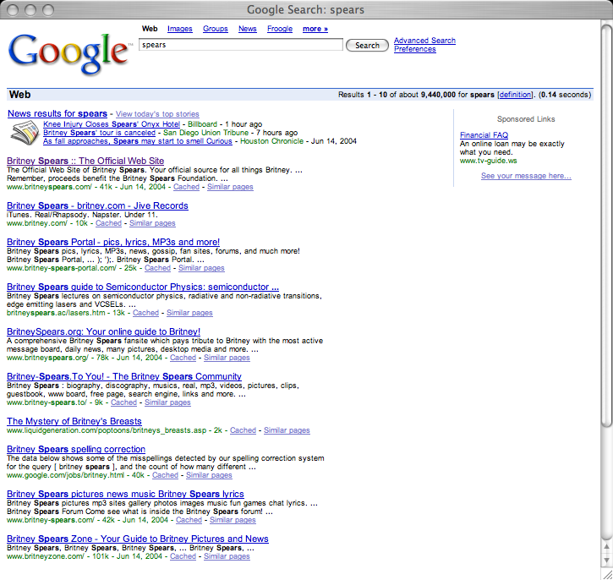
Web Crawling
Q: How does a search engine know that all these pages contain the query terms?
A: Because all of those pages have been crawled
2

Slide 3
Web Crawling
Web Crawlers are programs that automatically download web pages.
Many Names
Crawler
Spider
Robot (or bot)
Web agent
Wanderer, worm, …
And famous instances: googlebot, scooter, slurp, msnbot, …
3

Slide 4
Web Crawling
Web Crawlers are programs that automatically download web pages.
A crawler can visit many sites to collect information that can be analyzed and mined in a central location, either online (as it is downloaded) or off-line (after it is stored).
Simply, Crawling is the process by which search engines discover updated content on the web, such as new sites or pages, changes to existing sites and dead links.
4

Slide 5
Web Crawling
Applications:
Support universal search engines (Google, Yahoo, MSN/Windows Live, Ask, etc.)
Vertical (specialized) search engines, e.g. news, shopping, papers, recipes, reviews, etc.
Business Intelligence: keep track of potential competitors, partners
Monitor Web pages and give notification to users or community
Phishing, spamming,etc
5

Slide 6
Web Crawling
Web Crawlers are used to support search engines.
Crawlers are main consumers of Internet bandwidth
Web crawlers collect pages for search engines to build their indexes.
6

Slide 7
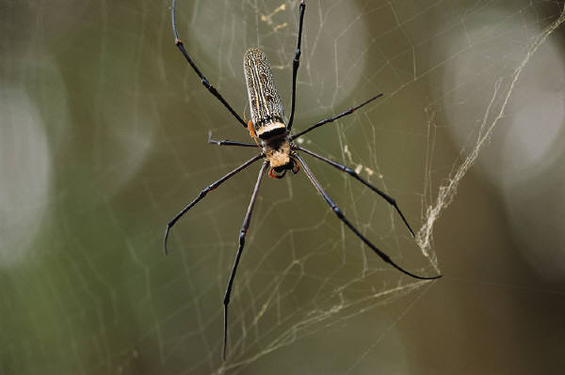
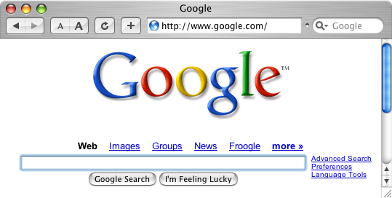
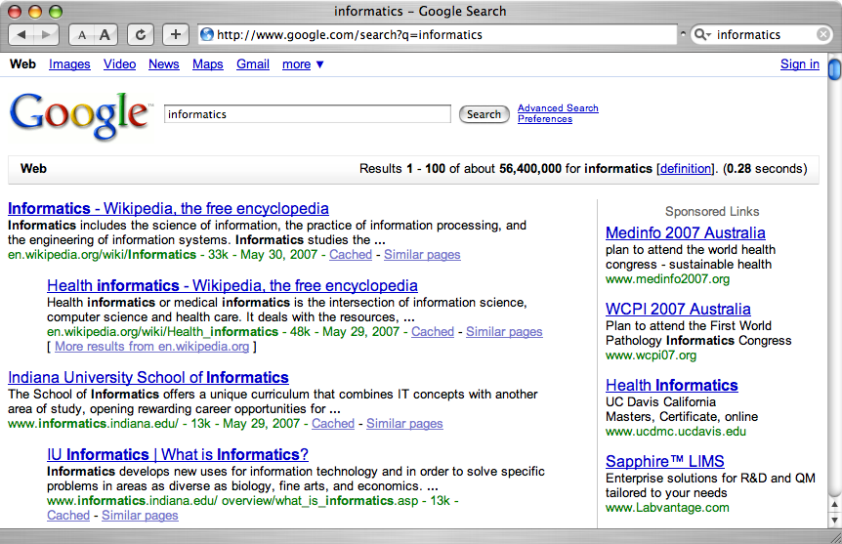
A crawler within a search engine
Web
Page repository
googlebot
Text & link analysis
Query
hits
Text index
PageRank
Ranker

Slide 8
One taxonomy of crawlers
Many other criteria could be used:
Incremental, Interactive, Concurrent, Etc.

Slide 9
Web Crawling
Basic Crawling Algorithm:
It starts from a set of seed pages (URLs).
It uses the links within those seed pages to fetch other pages.
The links in these pages are, in turn, extracted and the corresponding pages are visited.
The process repeats until a sufficient number of pages are visited or some other objective is achieved.
This simple basic algorithm hides many delicate issues
Related to network connections
Spider traps
URL canonicalization
Page Parsing and crawling ethics.
9

Slide 10
Web Crawling
BasicCrawling Algorithm:
It starts from a set of seed pages (URLs).
It uses the links within those seed pages to fetch other pages.
The links in these pages are, in turn, extracted and the corresponding pages are visited.
The process repeats until a sufficient number of pages are visited or some other objective is achieved.
This simple basic algorithm hides many delicate issues
Related to network connections
Spider traps
URL canonicalization
Page Parsing and crawling ethics.
10

Slide 11
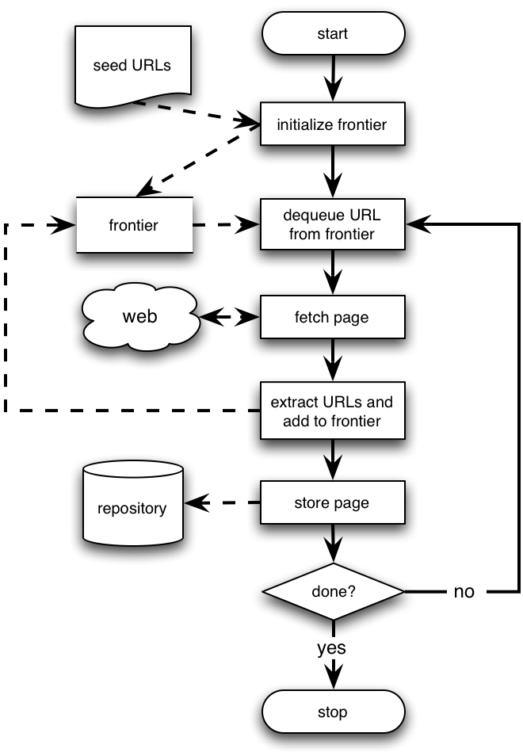
Web Crawler
Crawler fetches one page at a time (limitation)
Crawler maintains unvisited list of URLs called Frontier.
Seeds can be any list of starting URLs → provided by user or another program

Slide 12
Web Crawling
Basic Sequential Crawling Algorithm:
In each iteration of its main loop
The crawler picks the next URL from the frontier
Fetches the page corresponding to the URL through HTTP
Parses the retrieved page to extract its URLs
Adds newly discovered URLs to the frontier
Stores the page (or other extracted information, possibly index terms) in a local disk repository
Stop criterion can be anything
After certain number of pages have been crawled
If the frontier is empty (rarely happens)
12

Slide 13
Web Crawling
A crawler is, in essence, a graph search algorithm
The Web can be seen as a large graph with pages as its nodes and hyperlinks as its edges.
A crawler starts from a few of the nodes (seeds) and then follows the edges to reach other nodes.
The process of fetching a page and extracting the links within it is analogous to expanding a node in graph search.
13

Slide 14
Web Crawling
The frontier is a data structure, which contains the URLs of unvisited pages.
Stores the frontier in main memory for efficiency.
A crawler designer must decide which URLs have low priority and thus get discarded when the frontier is filled up.
The crawler algorithm must specify the order in which new URLs are extracted from the frontier to be visited.
These mechanism determine the graph search algorithm implemented by crawler.
14

Slide 15
Web Crawling
Breath-First Crawler:
The frontier may be implemented as a first-in-first-out (FIFO) queue, corresponding to a breadth-first crawler.
The URL to crawl next comes from the head of the queue and new URLs are added to the tail of the queue.
Once the frontier reaches its maximum size, the breadth-first crawler can add to the queue only one unvisited URL from each new page crawled
It does not follows random order of page visiting. (reasons)
an intrinsic bias of search engines to index well connected pages.
greatly affected by the choice of seed pages
15

Slide 16
Web Crawling
Preferential Crawler:
The frontier may be implemented as a priority queue.
It assign each unvisited link a priority based on an estimate of the value of the linked page.
The estimate can be based on
Topological properties (indegree of target page)
content properties (the similarity between a user query and the source page)
Any other combination of measurable features
Best – first Crawler → if pages are visited in the order specified by the priority values in the frontier.
16

Slide 17
Web Crawling
Implementation Issues:
Don’t want to fetch same page twice!
Keep lookup table (hash) of visited pages
What if not visited but in frontier already?
The frontier grows very fast!
May need to prioritize for large crawls
Fetcher must be robust!
Don’t crash if download fails
Timeout mechanism
Determine file type to skip unwanted files
Can try using extensions, but not reliable
Can issue ‘HEAD’ HTTP commands to get Content-Type (MIME) headers, but overhead of extra Internet requests
17

Slide 18
Web Crawling
Implementation Issues: Fetching
To fetch pages, a crawler acts as a Web client.
it sends an HTTP request to the server hosting the page and reads the response.
Clients needs to time out connection
Slow servers
Reading huge pages
Restrict downloads to only first 10-100KB of data of each page.
It parses the response headers for status codes and redirections.
Hashing techniques is used to avoid duplicate
Age of the document
18

Slide 19
Web Crawling
Implementation Issues: Fetching
Error – Checking and Exception Handling → same code must deal with potentially millions of remote servers
collect statistics on timeouts and status codes. → to identify problem or adjust timeouts automatically.
Java, Python and Perl has programmatic interfaces for fetching pages from the Web.
19

Slide 20
Web Crawling
Implementation Issues: Parsing
Once (or while) a page is downloaded, the crawler parses its content i.e HTTP payload.
It extracts information both to
To support crawler’s master application e.g., indexing the page if the crawler supports a search engine)
To allow the crawler to keep running (extracting links to be added to the frontier).
20

Slide 21
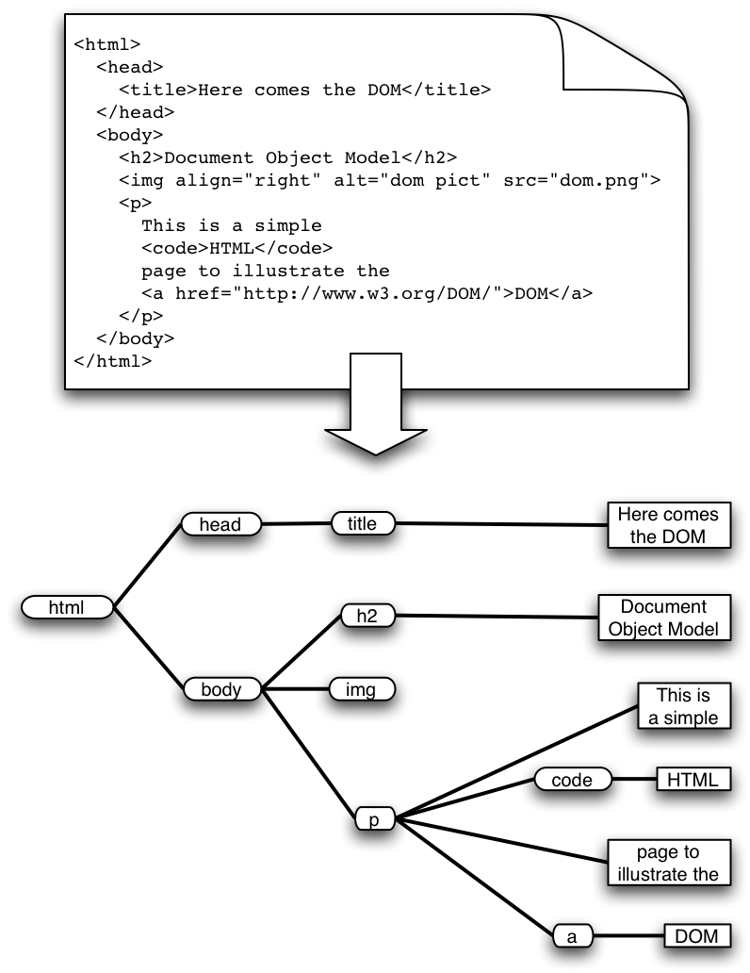
Web Crawling
Implementation Issues: Parsing
21

Slide 22
Web Crawling
Implementation Issues: Parsing
HTML has the structure of a DOM (Document Object Model) tree
Unfortunately actual HTML is often incorrect in a strict syntactic sense
Crawlers, like browsers, must be robust/forgiving
Fortunately there are tools that can help
E.g. tidy.sourceforge.net
Must pay attention to HTML entities and unicode in text
22

Slide 23
Web Crawling
Implementation Issues: Stop-Word Removal and Stemming
When parsing a web page to extract the content or to score new URLs suggested by the page, it is often helpful to remove stop-words.
Another useful technique is stemming, by which morphological variants of terms are conflated into common roots (stems).
23

Slide 24
Web Crawling
Implementation Issues: Link Extraction and Canonicalization
HTML parsers provide the functionality to identify tags and associated attribute-value pairs in a given Web page.
In order to extract hyperlink URLs from a page, we can use a parser to find anchor (<a>) tags and grab the values of the associated href attributes.
However, the URLs thus obtained need to be further processed.
Filtering may be necessary to exclude certain file types that are not to be crawled.
White list → only follow links to text/html content pages
Black List → discard links to PDF files
24

Slide 25
Web Crawling
Implementation Issues: Link Extraction and Canonicalization
Another type of filtering has to do with the static or dynamic nature of pages.
A dynamic page may indicate a query interface for a database or some other application in which a crawler may not be interested.
Now a days, most crawlers no longer make such distinction between static and dynamic content.
Before links can be added to the frontier, relative URLs must be converted to absolute URLs.
25

Slide 26
Web Crawling
Implementation Issues: Link Extraction and Canonicalization
Crawler must translate relative URLs into absolute URLs
Need to obtain Base URL from HTTP header, or HTML Meta tag, or else current page path by default
Examples
Base: http://www.cnn.com/linkto/
Relative URL: intl.html
Absolute URL: http://www.cnn.com/linkto/intl.html
Relative URL: /US/
Absolute URL: http://www.cnn.com/US/
26

Slide 27
Web Crawling
Implementation Issues: Link Extraction and Canonicalization
Converting relative URLs is just one of many steps that make up the canonicalization process.
All of these:
http://www.cnn.com/TECH
http://WWW.CNN.COM/TECH/
http://www.cnn.com:80/TECH/
http://www.cnn.com/bogus/../TECH/
Are really equivalent to this canonical form:
http://www.cnn.com/TECH/
In order to avoid duplication, the crawler must transform all URLs into canonical form
Definition of “canonical” is arbitrary, e.g.:
Could always include port
Or only include port when not default :80
27

Slide 28
Web Crawling
Implementation Issues: spider traps
Misleading sites: indefinite number of pages dynamically generated by CGI scripts
Paths of arbitrary depth created using soft directory links and path rewriting features in HTTP server
Only heuristic defensive measures:
Check URL length; assume spider trap above some threshold, for example 128 characters
Watch for sites with very large number of URLs
Eliminate URLs with non-textual data types
May disable crawling of dynamic pages, if can detect
28

Slide 29
Web Crawling
Implementation Issues: Page Repository
Once a page is fetched, it may be stored/indexed for the master application
Naïve: store each page as a separate file
Can map URL to unique filename using a hashing function, e.g. MD5
This generates a huge number of files, which is inefficient from the storage perspective
Better: combine many pages into a single large file, using some XML markup to separate and identify them
Must map URL to {filename, page_id}
Database options
Any RDBMS -- large overhead
Light-weight, embedded databases such as Berkeley DB
29

Slide 30
Web Crawling
Implementation Issues: Concurrency
A crawler incurs several delays:
Resolving the host name in the URL to an IP address using DNS
Connecting a socket to the server and sending the request
Receiving the requested page in response
Solution: Overlap the above delays by fetching many pages concurrently
30

Slide 31
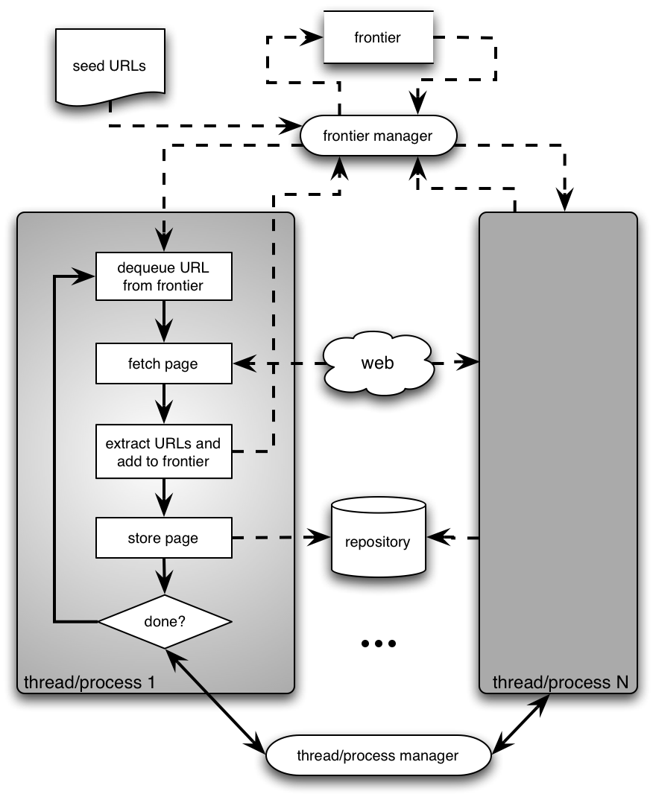
Web Crawling
Implementation Issues: Concurrency
31

Slide 32
Web Crawling
Implementation Issues: Concurrency
Can use multi-processing or multi-threading
Each process or thread works like a sequential crawler, except they share data structures: frontier and repository
Shared data structures must be synchronized (locked for concurrent writes)
Speedup of factor of 5-10 are easy this way
32

Slide 33
Web Crawling
33

Slide 34
Use Case on Web Usage Mining
Session and Visitor Analysis:
The statistical analysis of pre-processed session data constitutes the most common form of analysis.
Data is aggregated by predetermined units
Days
Sessions
Visitors
Domains
Standard Statistical techniques are used on this data to gain knowledge about visitor behaviour.
34

